Slide 1
Zomato Restaurants Analysis
A demonstration by Arpit Shrotriya

Slide 2

Online Delivery Restaurants

Slide 3

Spreadsheet Project:
Zomato Restaurants Analysis

Slide 4

Data Cleaning
In this phase of the project, the focus was on preparing the data for analysis by cleaning it and addressing any inconsistencies or missing values. The following steps were taken to clean the data using appropriate Excel formulas
Handling Null or Mishandled Values
Filling Country Names Using VLOOKUP
Ensuring Consistency and Accuracy

Slide 5


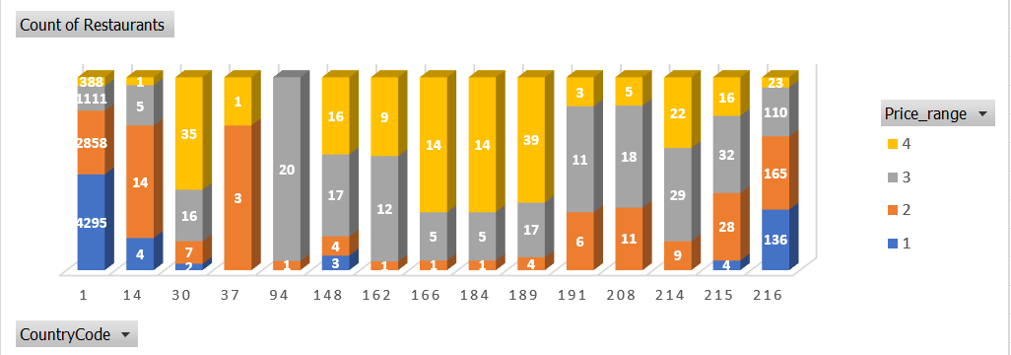
1. Restaurant Distribution by Country
This slide presents a table illustrating the distribution of restaurants opened in each country, providing valuable insights into the geographic spread of restaurant establishments.

Slide 6
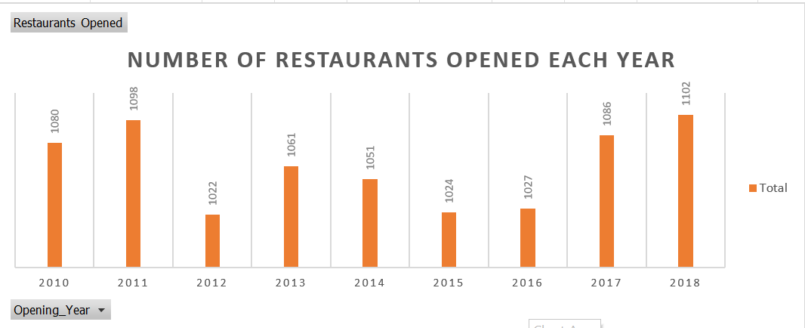
Restaurants Opened Each Year

Slide 7
Countries with Lesser Competition
Recommendations for countries where opening new restaurants could be strategically advantageous based on an analysis of the count of restaurants and the average cost for two people.
Canada (Country Code 37):
Reasoning: With only four cities having one restaurant each, Canada presents potential areas with relatively low competition, indicating opportunities for market entry and growth.
Insights: The limited number of restaurants coupled with a diverse culinary landscape and moderate average cost for dining out make Canada an attractive market for new restaurant ventures.
Australia (Country Code 14):
Reasoning: Australia exhibits a favorable landscape for new restaurant openings, with each city featuring only one restaurant and offering nominal prices for dining out.
Insights: The combination of low competition and affordable dining options suggests a conducive environment for establishing new culinary ventures in Australia.

Slide 8
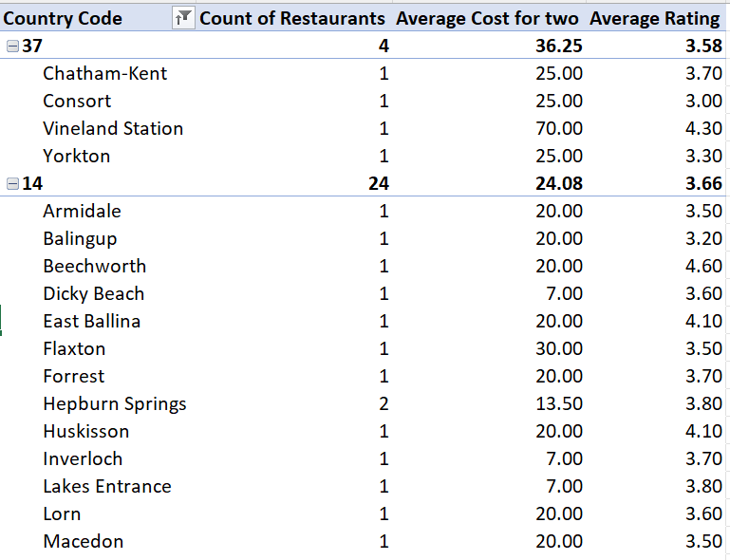
Current Quality of Restaurants
A comprehensive analysis of the current quality of restaurants in the suggested countries based on ratings and the count of votes.
By examining these key metrics, stakeholders gain valuable insights into customer satisfaction levels and the overall performance of restaurants within the target markets.

Slide 9
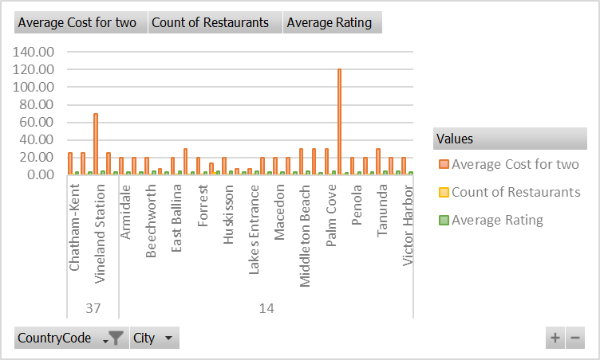
Expenditure on Food in Suggested Countries
A concise summary of the average cost for two people dining out in the suggested countries. By presenting this information, stakeholders gain valuable insights into the financial expenditure associated with operating.

Slide 10

Influence of Online Delivery and Table Booking
By examining the correlation between service offerings and customer feedback, stakeholders gain valuable insights into the importance of these services in enhancing overall customer satisfaction and loyalty.

Slide 11

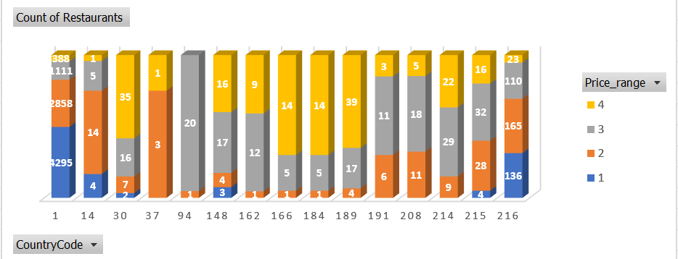
Distribution of Different Price Ranges

Slide 12

Conclusion
Key findings derived from the analysis conducted on various aspects of the restaurant industry, accompanied by actionable recommendations for stakeholders.
Customer Preferences and Satisfaction
Competitive Landscape and Market Opportunities
Financial Considerations and Cost Management

Slide 13

Thank you
We look forward to the opportunity for expanding restaurants to new countries to collaborate with you and contribute to the culinary-success in the future.

